Slide 1
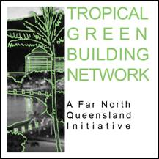
Tropical Air Conditioning with a “Green” tinge focus on Energy Saving Developments in the Home
Presentation by Keiren O’Brien
2nd September 2009
for:

Slide 2
The two biggest challenges to sustainable air conditioning in the tropics;
1: Price – Current technologies Vs Alternative technologies is at least half the capital cost excluding ongoing maintenance costs.
2: Suitability to our tropical environment – High humidity and temperature, rainfall, the natural environment and our built environment.

Slide 3
Part: A
Developments in the current conventional products on the market
Part: B
Alternative products entering the market with potential to be commercially viable and adopted within the industry

Slide 4

Current Conventional Products
“News Flash”:
1st September 2009, Queensland Government bans the sale and installation of inefficient home air conditioners. MEPS changes for Queensland.
31st August 2009, Queensland Retail Chain Industry celebrates record air conditioner sales in August before MEPS deadline looms.

Slide 5
What is MEPS
Minimum
Energy
Performance
Standards
A National minimum threshold for energy efficiency – air conditioning requirements outlined in AS3823.2
The measure of energy efficiency for cooling is the Energy Efficiency Ration (EER)
The higher the EER = more cooling capacity per kW of electrical input = greater energy efficiency

Slide 6
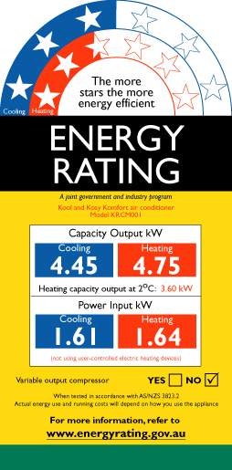
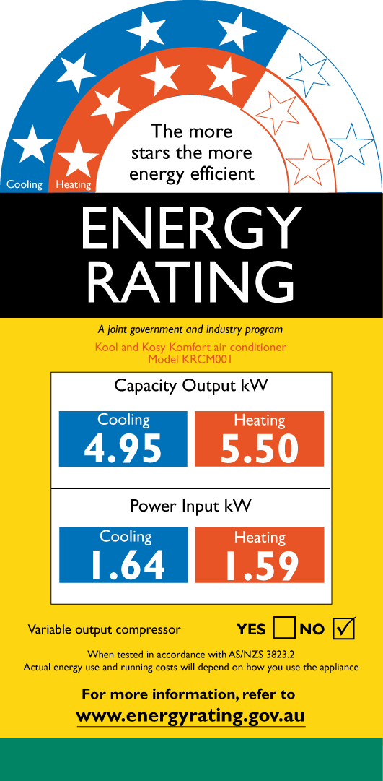

What are the changes to MEPS
From 1 September 2009, when an air-conditioner is installed (including replacement) in a new or existing house, townhouse or unit (i.e. Class 1 or 2 building), the air-conditioner must have a tested average Energy Efficiency Ratio (EER) of 2.9 or higher for cooling (QLD).
4 Star as of 1st September 2009 (2.9 EER)
2.5 Star prior to1st September 2009 (2.5 EER)

Slide 7
Compliance (DRAFT TO BE CONFIRMED)
The new requirement will apply to both new air-conditioners installed in an existing home, as well as the replacement of an air-conditioner in an existing home.
Complimentary provisions through amendments to the Queensland Development Code (QDC) and Electricity Regulation 2006 to prevent the sale or installation of inefficient air conditioners in Queensland from 1st September 2009
- The amendments to the Queensland Development Code (QDC) Mandatory Part (MP) 4.1 - Sustainable Buildings, set an increased minimum standard for energy efficiency of air-conditioners installed in houses, townhouses and units in Queensland from 1 September 2009. The new provisions are part of the Sustainable Housing Policy, which incorporates a wide range of measures to increase the energy and water efficiency of housing in Queensland.
- Complementary provisions banning the sale of air-conditioners in Queensland that do not meet the new energy efficiency requirements are proposed through amendments to the Electricity Regulation 2006. The sales ban is proposed to commence from 1 September 2009 so as to align with the installation ban under the QDC.

Slide 8
Enforcement and Penalties(DRAFT TO BE CONFIRMED)
“Compliance is the home owner’s responsibility”
As the installation of air-conditioners has been prescribed as self-assessable building work, it is the homeowner’s responsibility to ensure compliance with the QDC. Under the Integrated Planning Act 1997, a penalty of up to 165 penalty units (equivalent to $16,500) is applicable.
Under the Integrated Planning Act 1997, local governments have the power to enforce the provisions of the Queensland Development Code, e.g. if a complaint is made about an air-conditioner that was installed on or after 1 September 2009 and did not meet the new requirement, the local government may investigate and take any necessary action.

Slide 9
Benefits to the environment
& energy costs
Based on a Living Room size air conditioner a 1 Star MEPS rated air conditioner costs $294 per MEPS rated air conditioner $205 per annum
“Across Queensland, the new minimum EER is estimated to save around 12,500 tonnes of greenhouse gas emissions each year - equivalent to around 2900 cars off the road annually
collectively save Queenslanders over $1.7 million on their annual electricity bills.

Slide 10
Other energy saving factors with Conventional Air Conditioning
Treatment of the Fabric of the house for better thermal performance
System Design
Correct equipment selected to meet conditioning needs
Energy efficient technology
Maintaining equipment
Changing our air conditioning habits

Slide 11
Treatment of the Fabric of the house
“Mechanical heating and cooling should never be used as a substitute for good design.” – ‘Your Home’ technical manual
Treat with a better thermal performing building envelope
Biggest factors in the tropics
Heat through walls and windows; orientation, building materials, window tinting, external shading device walls/overhangs, landscaping ie use of trees
2. Heat through ceiling
Ceiling insulation, ventilated, attics ie not raked
Window tinting, external shade, insulation and ventilating the roof – potential to reduce heat load up to 35%

Slide 12
System Design
Oversized or Undersized – size equipment to meet actual needs of the conditioned space.
Oversized = short cycling of system (frequent stop / start + poor temperature control).
2. Undersized = continuous operation (system running non-stop excessive current draw) with poor temperature control
Correct type of system – A system should be matched to the conditioning requirements of the home.

Slide 13
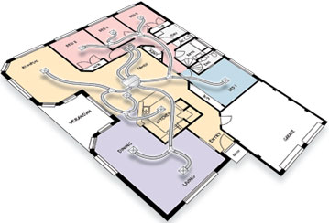
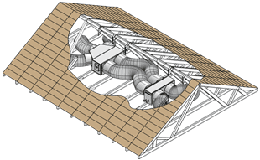
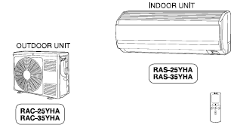
Split versus Ducted
FACTOR | DUCTED AIR CONDITIONING | WALL MOUNT SPLIT SYSTEM
1. Even temperature | Even temperature throughout room and entire home | Uneven temperature both within room and home. Cold in some parts of room hot and stuffy in other parts. Results in inefficient setting of controls.
2. Running Cost | A single ducted system typically cheaper to run than multiple hi wall split systems of equal total capacity. | Multiple splits are typically more expensive to run at once, more individual systems = more motors and therefore more energy losses
3. Life Cycle | Ducted air conditioning: 15 to 20 year working life | Split systems: Replacement in 7 -10 years
Source: www.temperzone.com.au

Slide 14
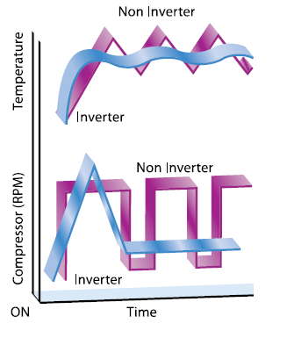
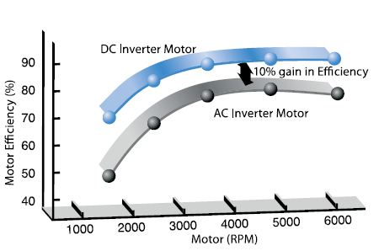
Inverter technology
30% more energy efficient than constant speed traditional air conditioning
Compressor speed modulates with temperature/capacity requirements rather than just start/stop
DC Inverter 10% improved efficiency Versus AC Inverter

Slide 15
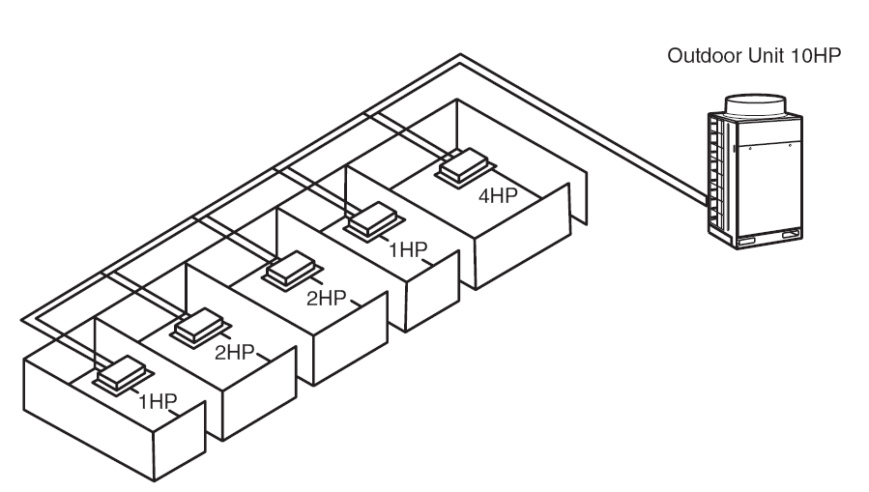
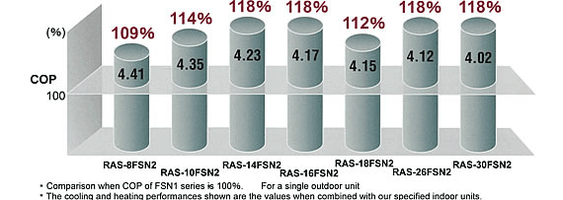
Multi-head Technology (VRV)
Single inverter driven outdoor unit
Single pipe run from outdoor unit to multiple indoors
Variable Refrigerant Volume control
“Potential to cut Carbon Emissions by 40%”

Slide 16
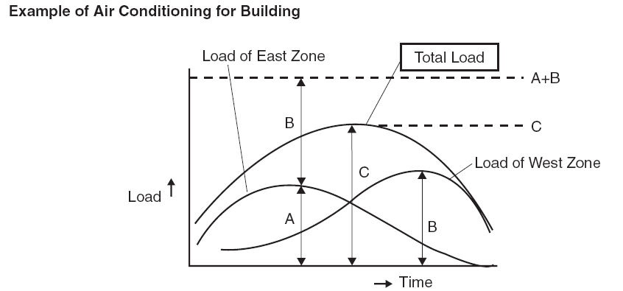
Multi-head Technology (VRV)
Peak air conditioning heat load is not static within the building at anyone point in time

Slide 17
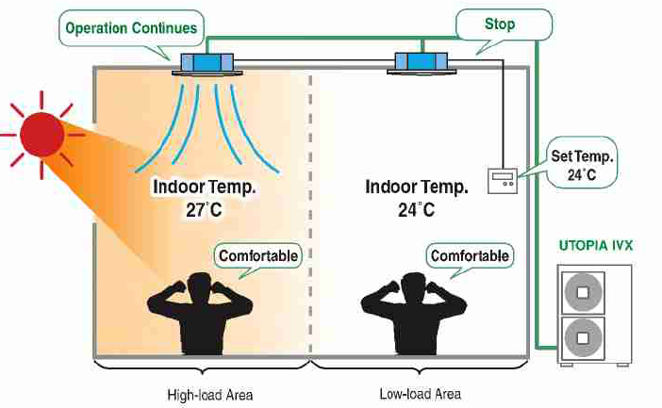
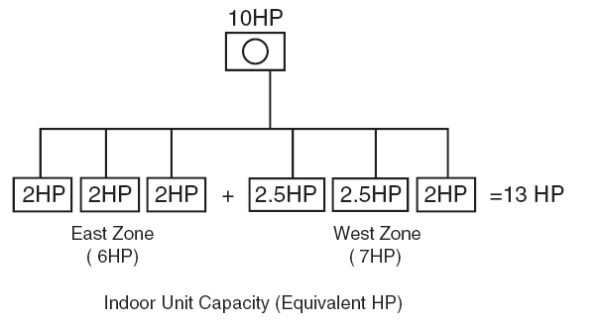
Multi-head Technology (VRV)
Results in more economical and energy efficient operation;
Only cools the areas actually requiring conditioning
2. Equipment can be sized with diversification in mind. Smaller capacity outdoor unit matched to higher capacity of combined indoor units, yet still capable of cooling peak loads in each individual zone

Slide 18
Changing our air conditioning Habits
Dress for the tropics. Blankets on the bed aren’t needed in Summer;
Close all external windows and doors;
Close window blinds/curtains, especially for windows facing East (in the morning) and West or North-west (in the afternoon) in summer;
Close internal doors, if possible, to separate areas that are occupied and require air-conditioning from those that are unoccupied;
Don’t set the thermostat to a more extreme temperature than is actually required (setting the thermostat lower in summer does not make the unit cool faster). Seasonal thermostat settings should be no less than 24ºC during summer.
Don’t leave an air-conditioner running if no-one will be home for more than an hour. This will provide little benefit on return and can waste large amounts of energy while home is unoccupied.
Keep system and return air filters clean.

Slide 19
Emerging Technologies toward sustainable air conditioning
Recently there is increasing effort in developing alternative technologies for air conditioning
Two emerging technologies appear to be gaining momentum in residential applications;
Geothermal
Solar

Slide 20
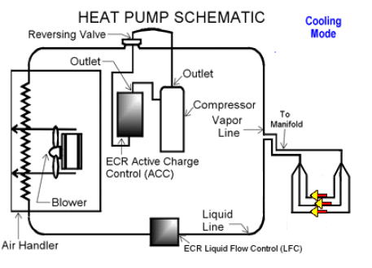
Geothermal
Geothermal technology in existence for decades
has Heat Pump type works similar to conventional air conditioning but heat removed in the conditioned space is expelled through the ground where the temperature is generally stable and cooler

Slide 21
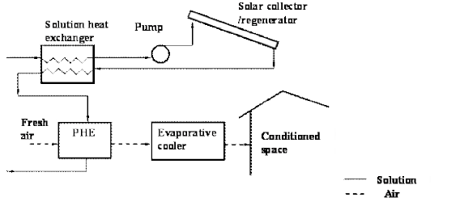
SOLAR
Sorption Type;
Absorption/Adsorption
Liquid Desiccant type;
Outside air is passed through the desiccant and moisture is removed from the air. By introducing a small amount of moisture back into the dehumidified air the temperature of the air rapidly falls
Benefit Removing excessive peak loads from Power Grid

