Slide 1

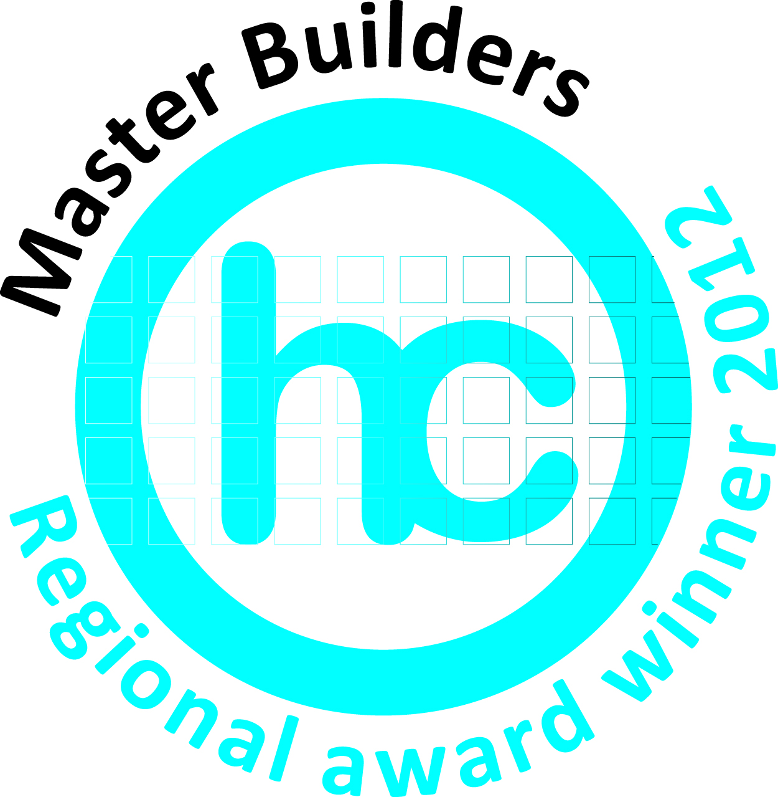

Adding value by building sustainably
Presented by Kenick constructions

Slide 2
Who we are..
Sophie Barrett Director of Green at Heart and past President of the Building Designers Association of Queensland (BDAQ), TGBN Steering Group member (and Kenick’s home Designer!)
Russell Parnicote Housing Industry Association (HIA)Cairns Branch Manager
Kent Hams Director Kenick Constructions and (HIA)Committee Member
Rachel Whymark Greensmart and building consultant Kenick Constructions

Slide 3
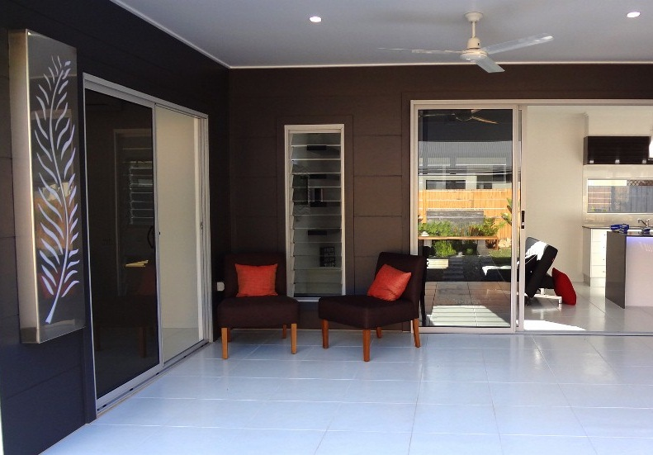
Purpose of today..
Outline what we do and how this has been perceived by both consumers and the industry
Highlight the issues we and others in the industry are facing as quality builders in our region
Understand your perspective and how we can better work together
Begin to place real values on aspects of sustainable and innnovative construction that clients are actively seeking
Begin the process of ongoing dialogue between affected and interested parties

Slide 4
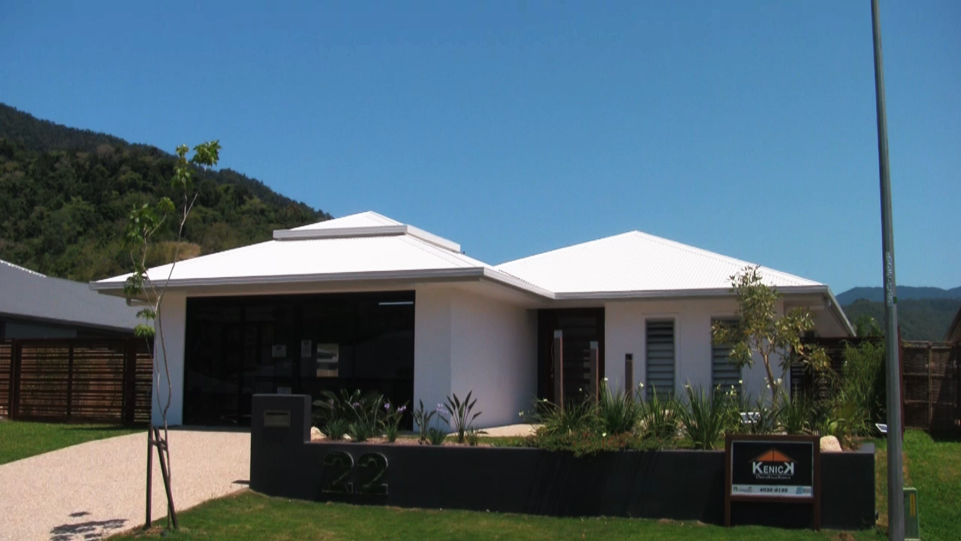
What we do..

Slide 5
22 Kippin close...
Is a 4 bedroom home with 2 bathrooms, double remote garage, stone benchtops and too many upgrades to mention
Clients water bill typically $20.00 a quarter
Credit of $195.00 last quarter for electricity
No gas bills
It has won a national award for sustainable design
But may be penalised on valuation as the floor area is only 188m2.
Why such a small footprint?
  No wasted space to areas such as hallways (a good thing) which saves between around 10m2 and 30m2 compared to most other builders designs
  Timber frame (will save around 4 – 6m2 than a masonry home)
  This home feels spacious and airy, with a large 4.6m x 4m patio, good sized bedrooms (all more than 3m x 3m plus robes), WIR, and two great bathrooms

Slide 6
What we do..
Offer consumers designer homes suitable for our climate, at a project build cost. (We also carry out renovations and extensions work to existing homes)
Offer clients unprecedented expertise in tropical sustainable construction for a project home price. We build naturally cool homes which have low running costs and are affordable for most budgets.
We are one of a handful of builders in our region who are on the Building Standards Authority (BSA) board to carry out rectification work for other builders.
We actively participate in educating and improving knowledge about sustainable building through involvement with the TGBN and by using the display homes.
We actively network through the TGBN, HIA, Master Builders and other industry events to keep up to date/stay ahead.

Slide 7
Perception by consumers & industry
Innovation and sustainable housing is no longer just of interest to ‘tree huggers’. Over 200 people came to our 9.5 star rated display home launch in September last year.
Where statutory declarations have been mandatory, research has indicated that each additional star on the energy rating has a perceived value of around 3% to buyers. (A.C.T study).
80% of our clients incorporate more than one of the design features which improves energy efficiency/water efficiency (investors generally don’t and account for the remaining 20%). Consumers are becoming much more educated and see saving money in the long term as common sense as fuel prices rise. Just as they do when purchasing a new car.
BEDI, BDAQ, HIA and Master Builders have all awarded our display homes (particularly 22 Kippin Close). Kippin has won Regional, state and National awards, and is well placed to win more awards in August. Support for affordable and well executed tropical homes is we would suggested well supported by the industry. (Latest award was for Sophie for Best Sustainable home in Australia from BEDI)
We had huge support from local suppliers and installers (TGBN members and our normal suppliers)

Slide 8
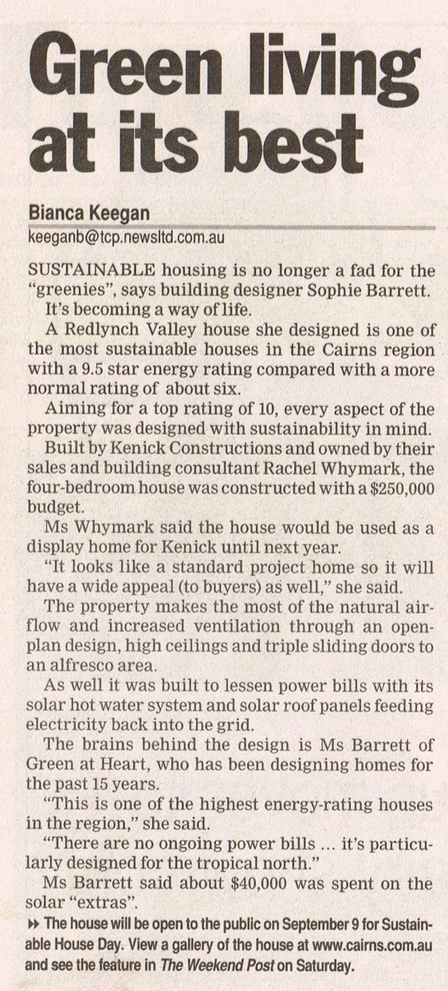
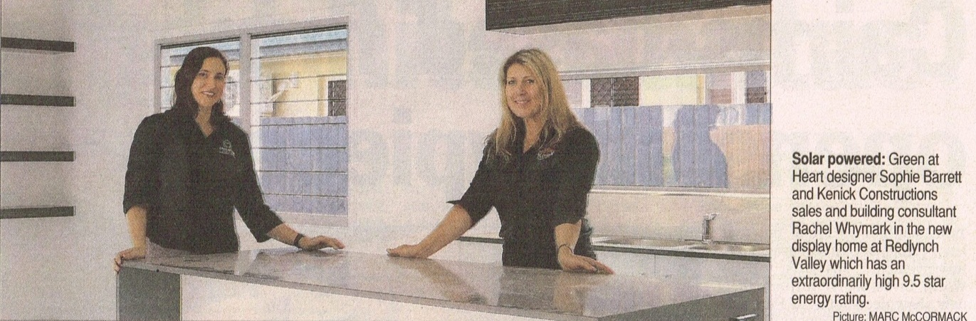

Slide 9
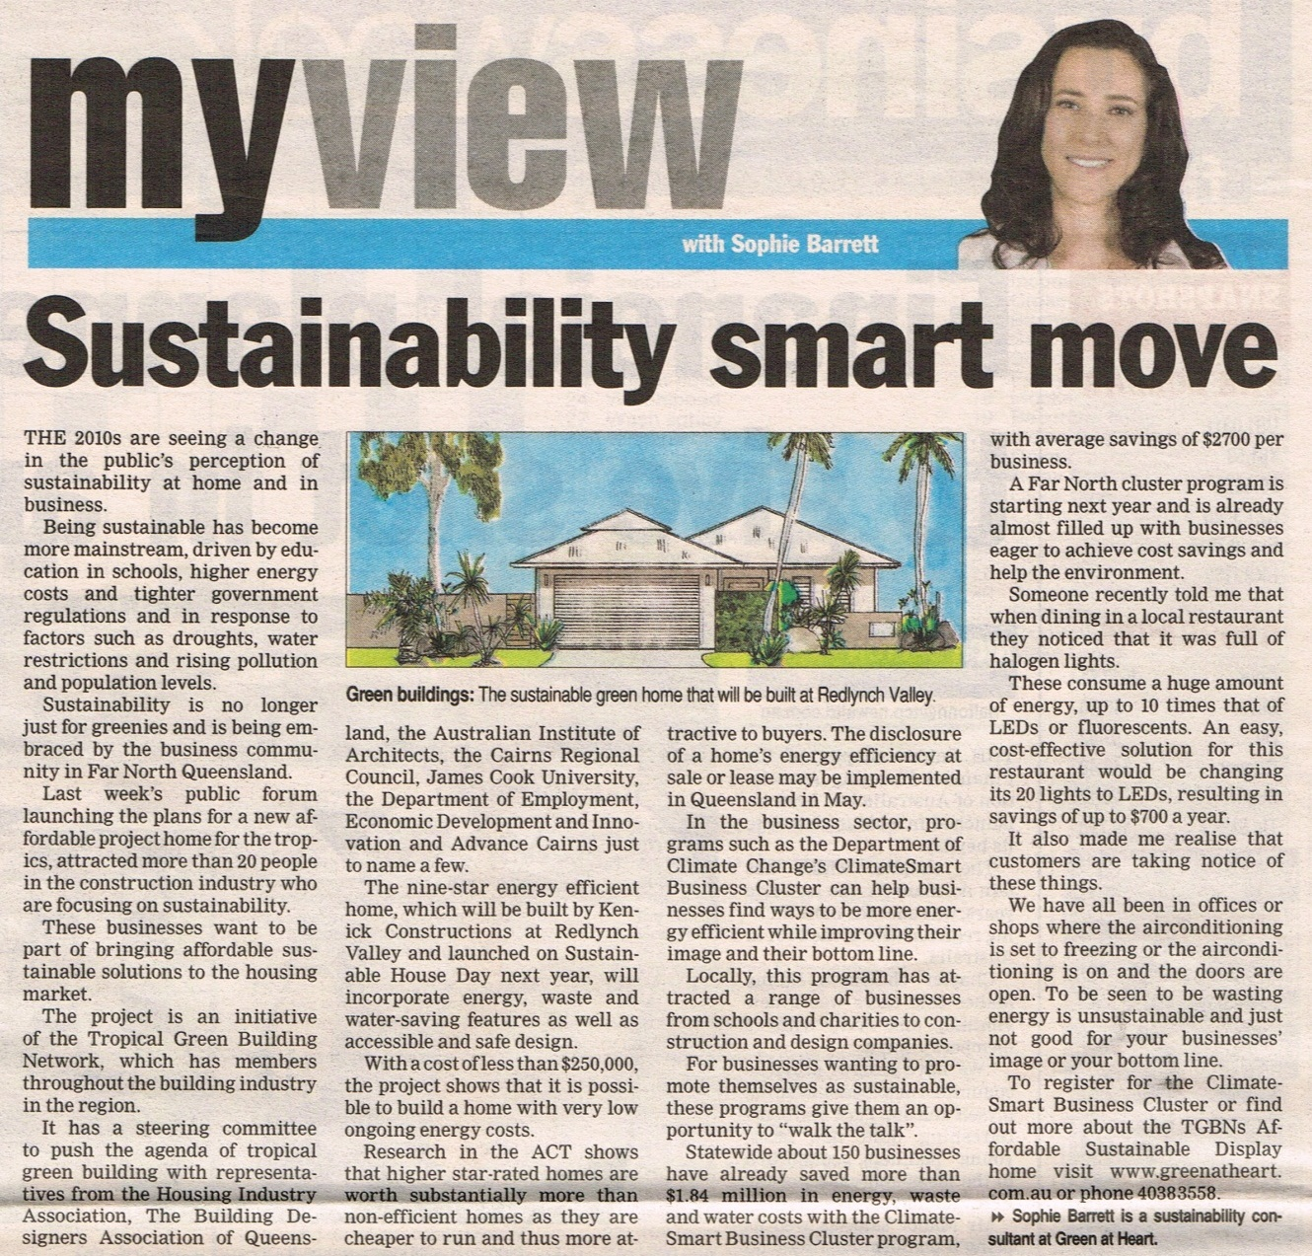

Slide 11
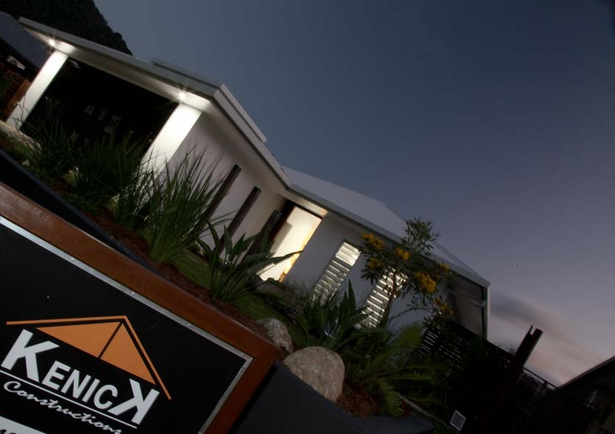
Key benefits of sustainable housing
Economic
  Energy and water saving (saves consumers money over time)
  Increased property values (ACT study)
  Decreased infrastucture strain
  Building costs can be lower (e.g. smaller footprints with better use of space)
Environmental
  Waste reduction
  C02 emmission reduction
  Water conservation
  Temperature moderation
  Stormwater management
Social
  Comfort
  Health
  Flexibility (e.g. Lifetime homes)

Slide 12
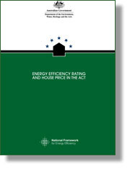
ACT study – Extra 3% per star
In 2007, the Department of the Environment, Water, Heritage and the Arts (DEWHA) commissioned the Australian Bureau of Statistics (ABS) to produce a statistical report modelling the relationship between the energy efficiency rating (EER) of houses and house prices in the Australian Capital Territory (ACT).
It shows that the ACT housing market, which in 1999 became the first jurisdiction in Australia to introduce mandatory energy disclosure for all houses on the market, places a higher value on energy efficiency and suggests that ‘location, location, EER’ has replaced the traditional real estate mantra of ‘location, location, location’ in the ACT.
The study looked at whether a relationship exists between the EER of a house and sale price using data from 2005 and 2006 and found that a statistically significant relationship does exist. This means, if a house has a higher EER than another house, but in all other respects the houses are the same, the house with the higher EER will command a higher price.

Slide 13
Issues we (and others face)
A very competitive established homes market
These homes would have cost less to build as built at a time when lower regulatory requirements were in place (e.g. Energy efficiency, cyclone requirements (garage doors) and health and safety).
Cheaper new house and land packages (speculative homes)
Homes that are built to minimum standards for the first home owner /investor market using (typically) inferior materials and trades and/or where the builder may also own the land and sell the homes in-house.
Lack of direct comparisons in a quiet market
Some of the jobs we have are on great blocks in new developments, this means it is often difficult to compare like with like.
Outlay of around $17,000 per home and cost of delays
  Clients with pre-approval go ahead to building contract (and pay a deposit of $5,000). However, our COSTS are nearer $17,000, yet we cannot reasonably expect this to be paid by clients without formal approval. This means a BIG risk to builders if contracts then fall over due to finance. Clients are also upset and confused as they have already recieved pre-approval.

Slide 14
Where we add value – as standard
Top quality tradespeople and materials. (We don’t shop around for contractors who are cheaper). One reason why our BSA record is impeccable.
Great designs to suit the tropics (passive design principles with design flair). Standard Kenick homes normally achieve 1 star higher than minimum requirement.
Finishing touches such as smooth render, sealing of gap between skirtings and tiles, grey tinted windows, R3.5 insulation, Panasonic air-conditioning, downlights and 1400mm ceiling fans, dishwasher, exposed aggregate driveway all as standard, quality tapware, and tiles throughout (including patios and bedrooms).
These are not upgrades, and are not just aimed at sustainability, they are features that we know make our homes more appealing and instill a sense of quality.

Slide 15
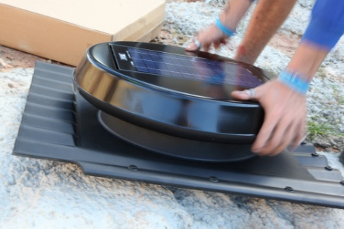
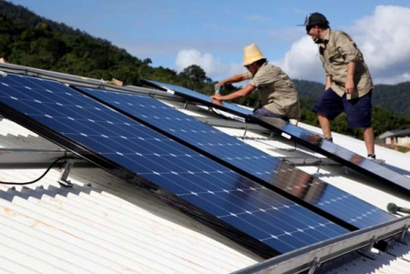
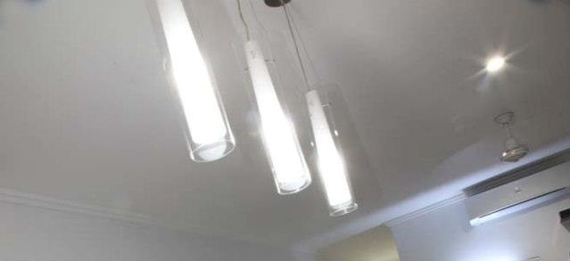
Where we add value – typical upgrades
  Solar PV (quality system) between $4,000 and $12,000
  L.E.D lights throughout (typically between $2,000 - $3,000)
  Ventilated roof space (soffits and ridge, using solar ridge vent) (typically around $1,000)
  Wider eaves (850mm inc. Gutter) (typically around $900)
  Insulated Timber frame (usually no extra cost)
  Insulation to garage/patio and porch roofs (typically around $1,100)

Slide 16
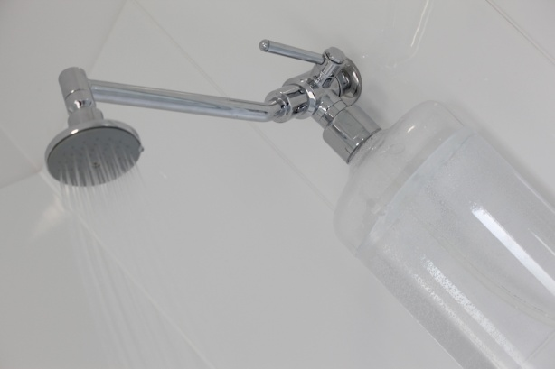
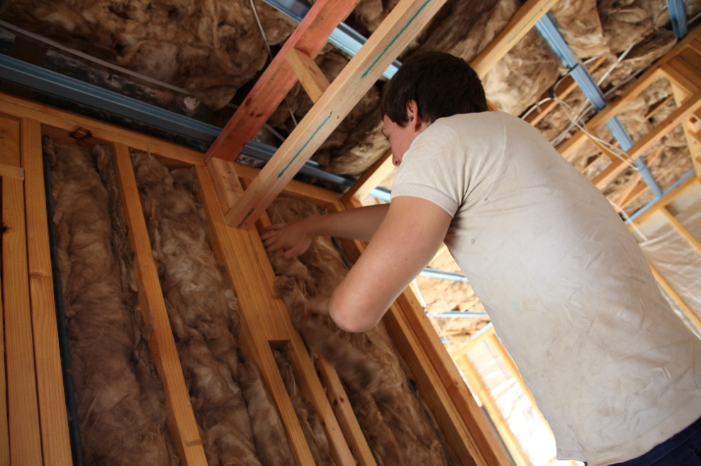
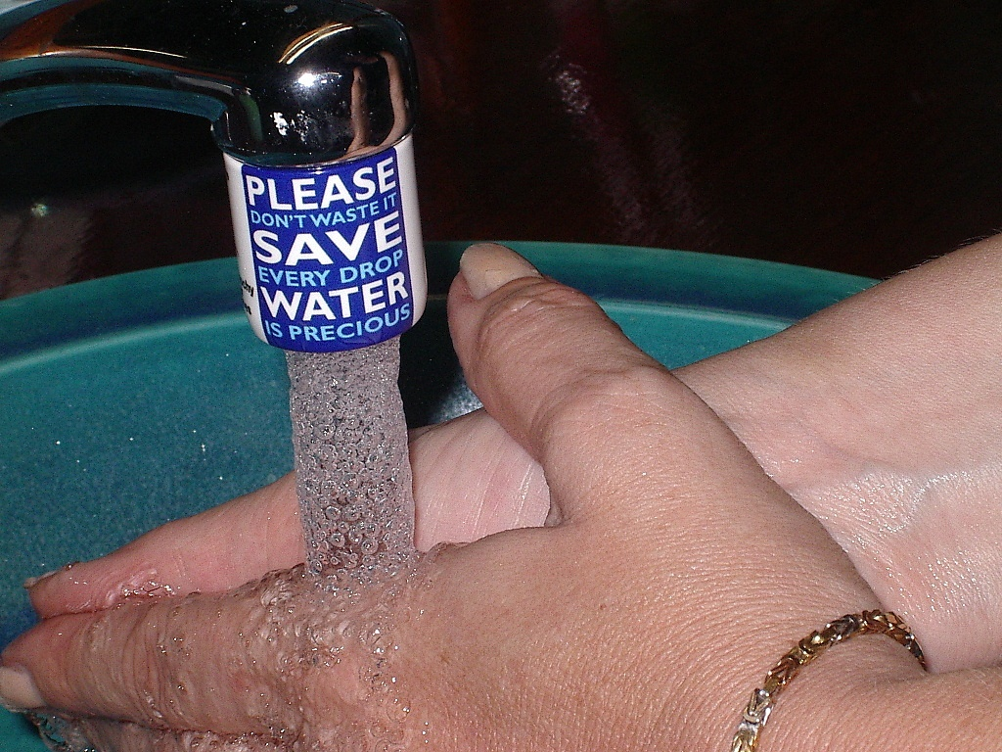
Where we add value – typical upgrades
  Water saving devices (from $500 - $6,000)
  Louvres (typically around $7,000)
  2.7m high ceilings (2.6m standard) (typically around $2,000)
  2.3m high internal doors (from $500 per house)
  Solar hot water (from $2,500)
  Foil under roof sheeting (from $1,500)
  Zoning to internal walls (i.e. Insulation $20perm2)

Slide 17
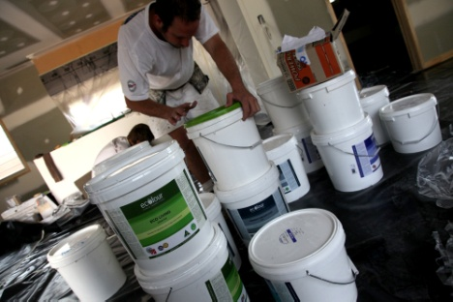
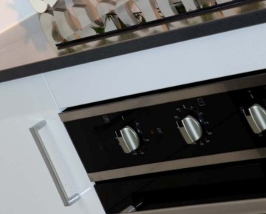
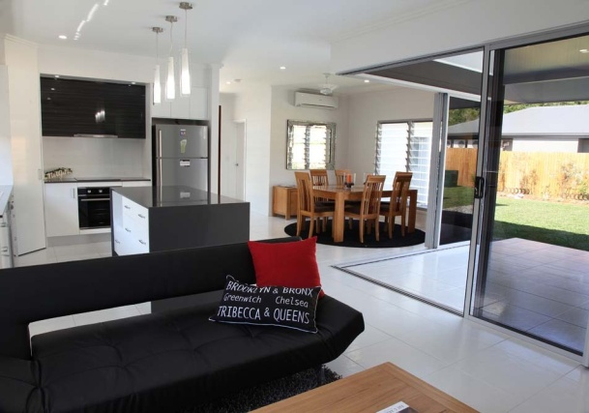
Where we add value – typical upgrades
  No volatile organic compound paint and cabinetry (VOC) (from $650)
  Induction cooktops (from $1,200)
  Higher specification air-conditioners (from $3,000, however, as air-con is usually not required, I suggest not upgrading these)
  Accessible (lifetime) homes upgrades (under $1,000)

Slide 18
Car analagy..
Cars (generally) have 4 wheels, and engine, a steering wheel and a body...they all get us from A to B..
However informed consumers know a new Mercedes has more value than a 5 year old Kia (sorry Kia!)
Due to petrol prices, many consumers are also looking at fuel economy
Not all homes are the same...We hit home runs on both quality AND fuel economy. Yet we (and other builders, are finding it increasingly hard to get bank approvals for some clients with lower deposits.

Slide 19
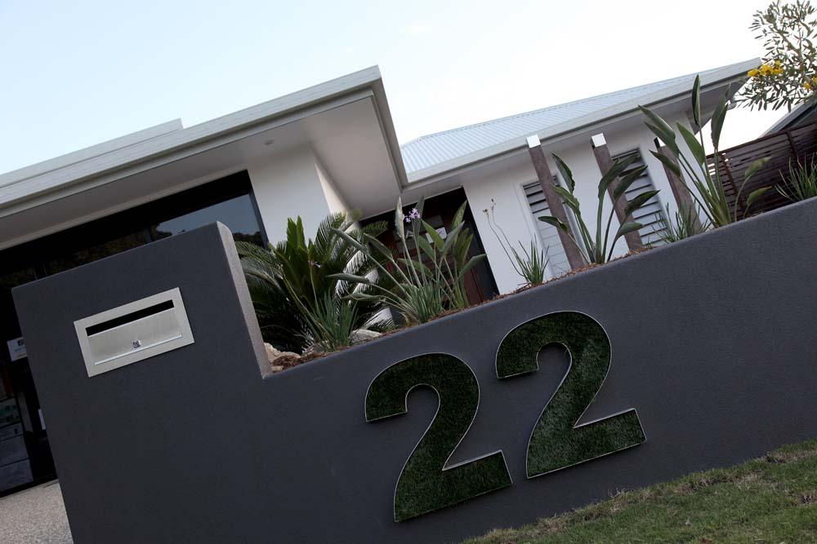
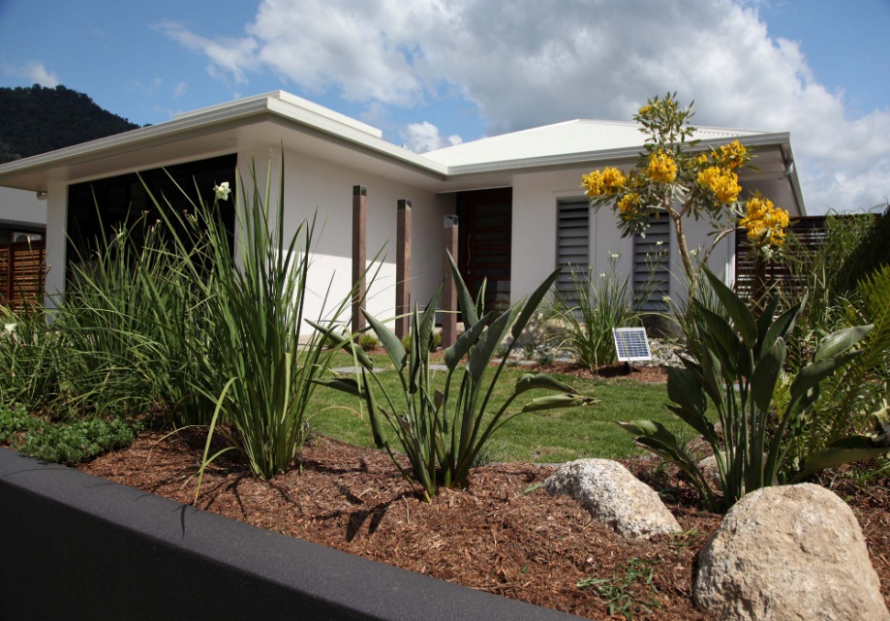
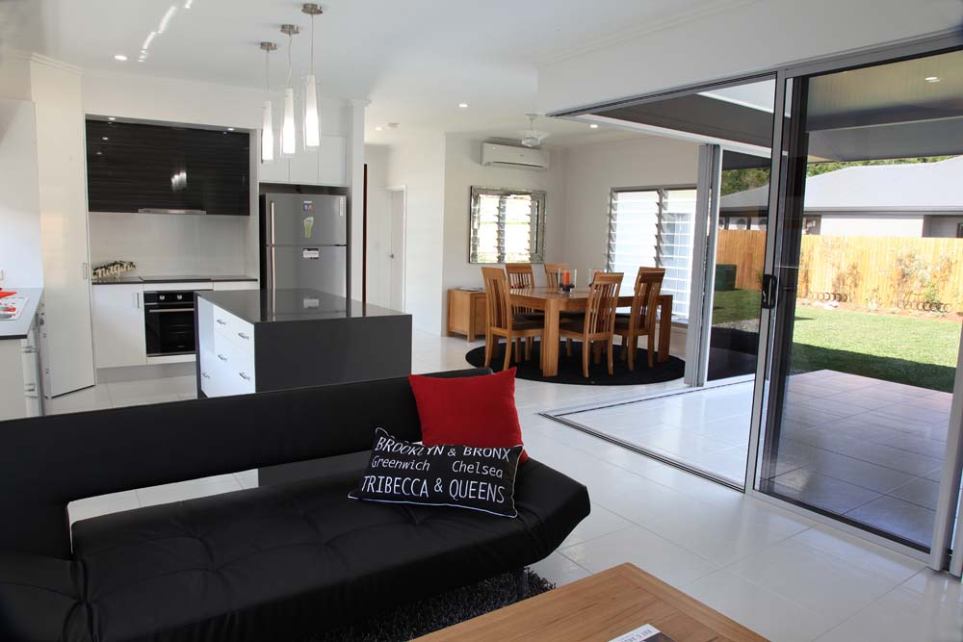
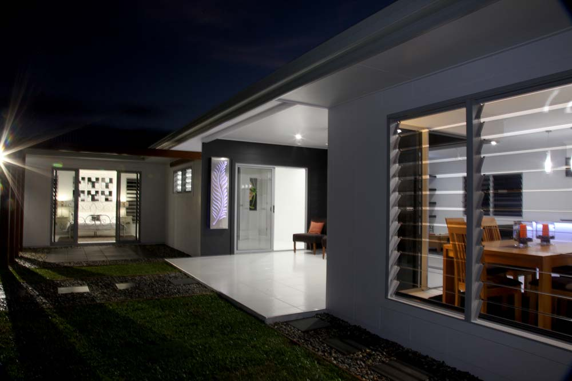
FINALLY..
We look forward to working with you so that we can continue offering a quality product that people are asking for more and more and that we love to build ☺
  THANK YOU FOR YOUR TIME!

